Slide 1
WELCOME

Slide 2

Selling festival's products
Navgujarat College Of
Computer Applications
Festopedia
Developed By:
Sagar Bhatt [04]
Amit Rana [76]
Meet Shah [84]
Submitted to:
Prof. Bhavik Pandya
Developed For:
Mr.Ajay Mehta

Slide 3
Index:
Introduction
Project Profile
Company Profile
Screen Layouts
Admin Side
User Side
Report Layouts
Future Enhancement
Conclusion
Bibliography

Slide 4
Introduction:
Project Definition:
(Selling Festival’s Product Onweb)
Project Description:
It is a administrative web application for Mahendra Merchandise to manage all the customer, manage customer order, manage payment, manage and parcel products and other facilities.

Slide 5
Project Profile:
Objective: Develop a web application that facilitates to show
information about festopedia
Plateform: Windows 10^{64bit}
Front End: PHP language and HTML
Back End: MySQL
Documentation Tools: MS Office 2010

Slide 6

Company Profile:
Company Name : Mahendra Merchandise
Company Owner : Mr.Ajay Mehta
Company Address :
Opp.Vijay Mills, Naroda Road, Ahmedabad.
Contact No : 9712379171

Slide 7
Screen layout(Admin side)

Slide 8
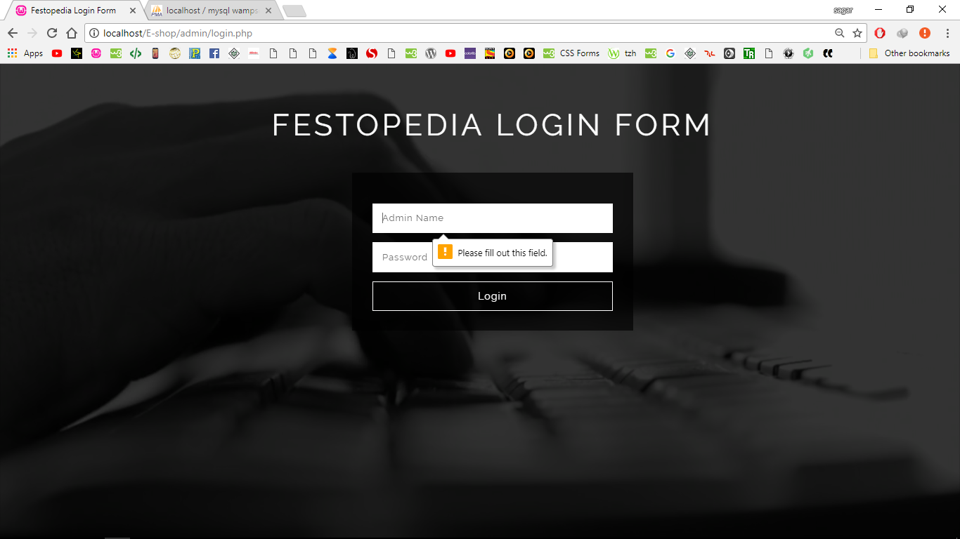
Login page validation

Slide 9
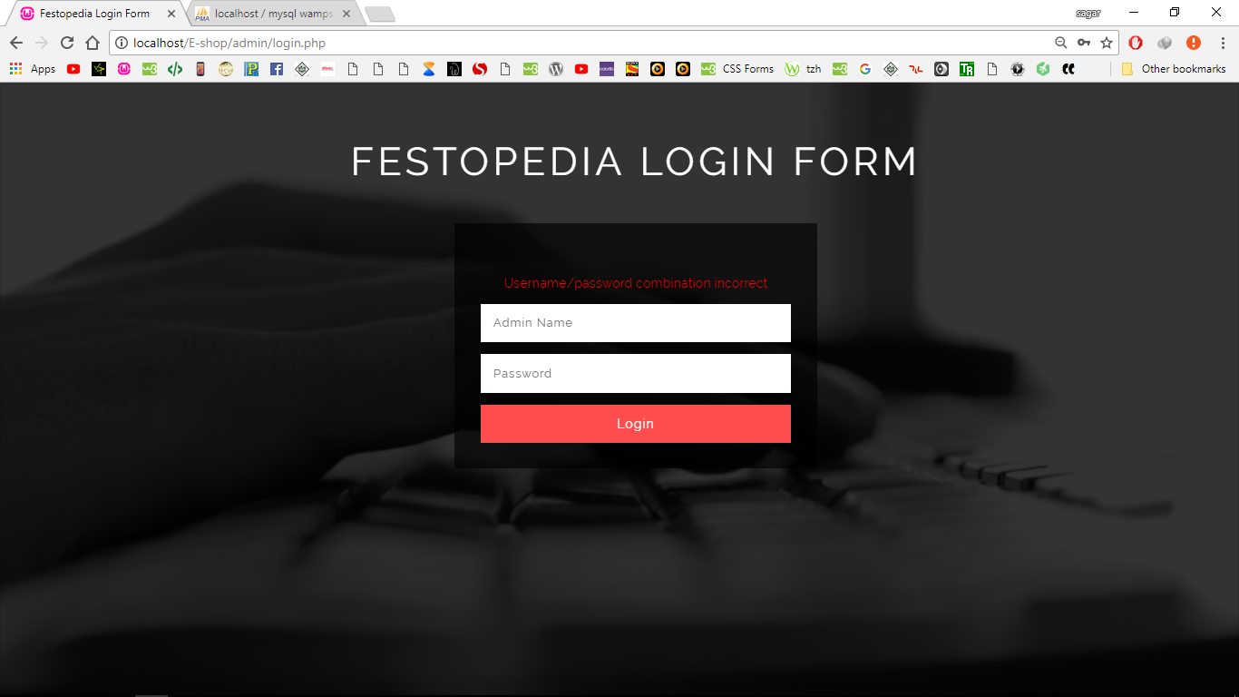
Login page error

Slide 10
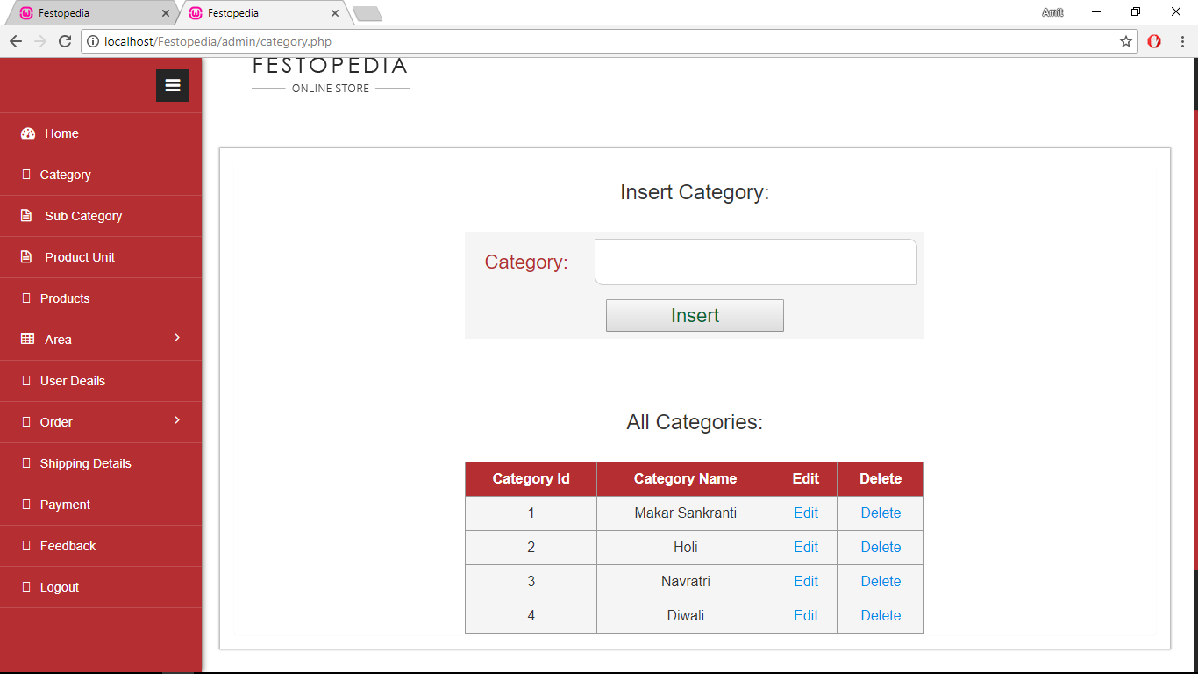
All Categories

Slide 11
Edit Category

Slide 12
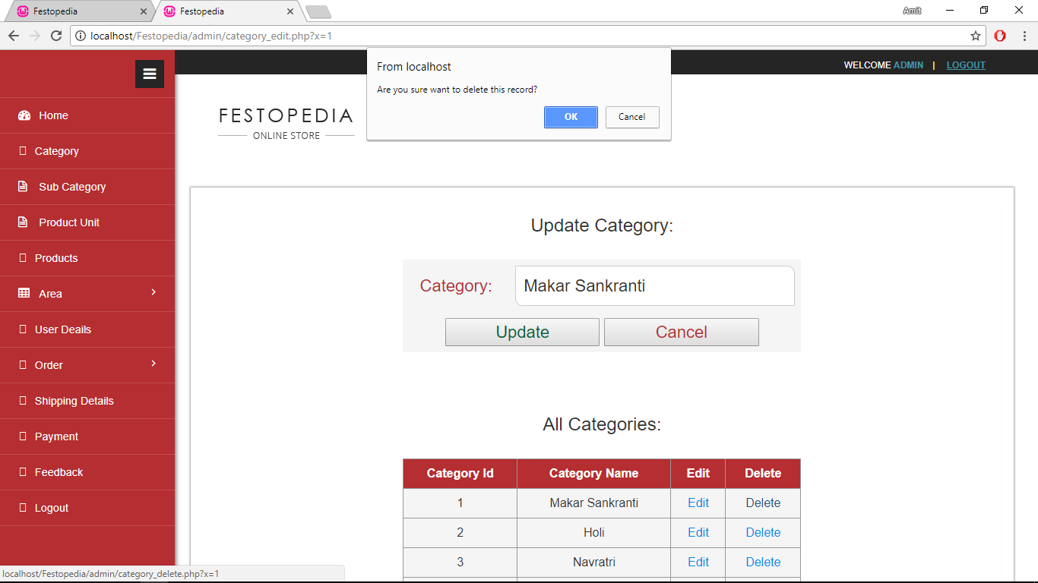
Delete Category

Slide 13
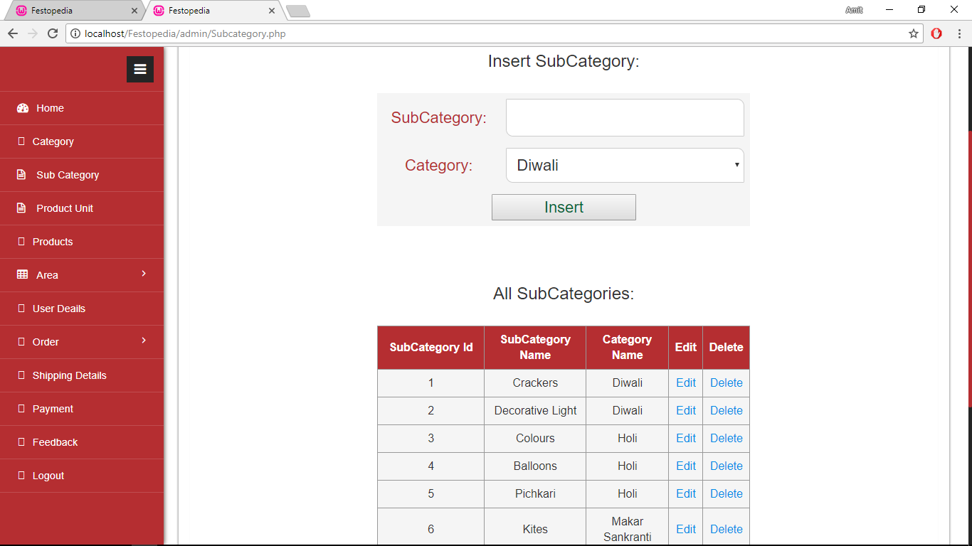
All Sub Categories

Slide 14
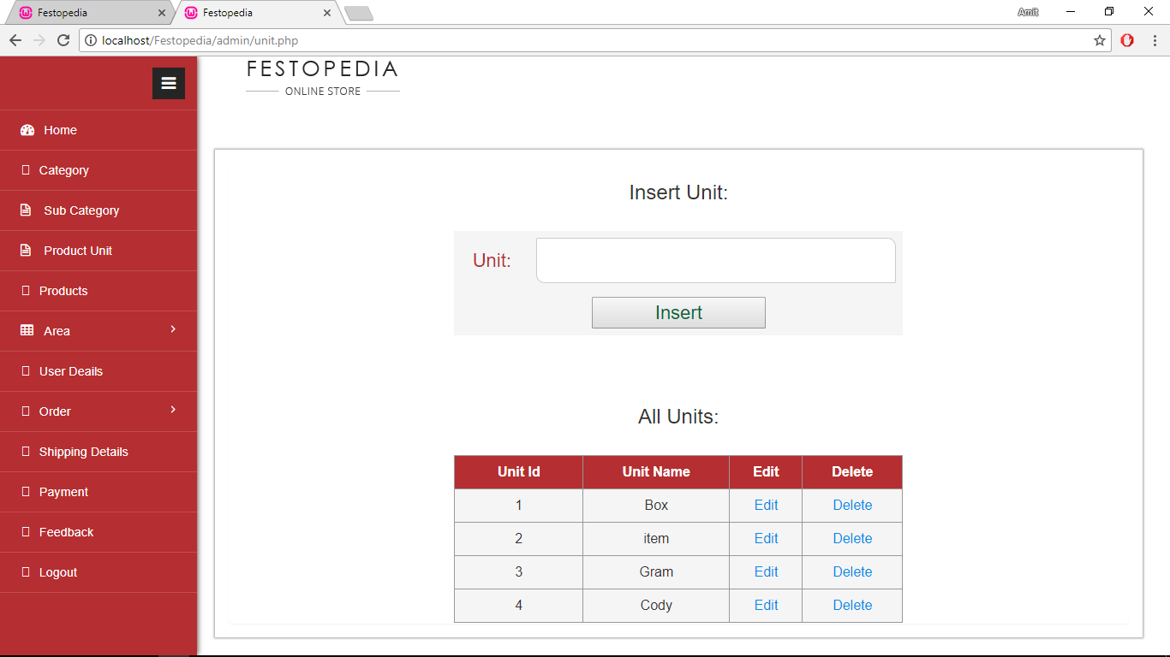
Product Units

Slide 15
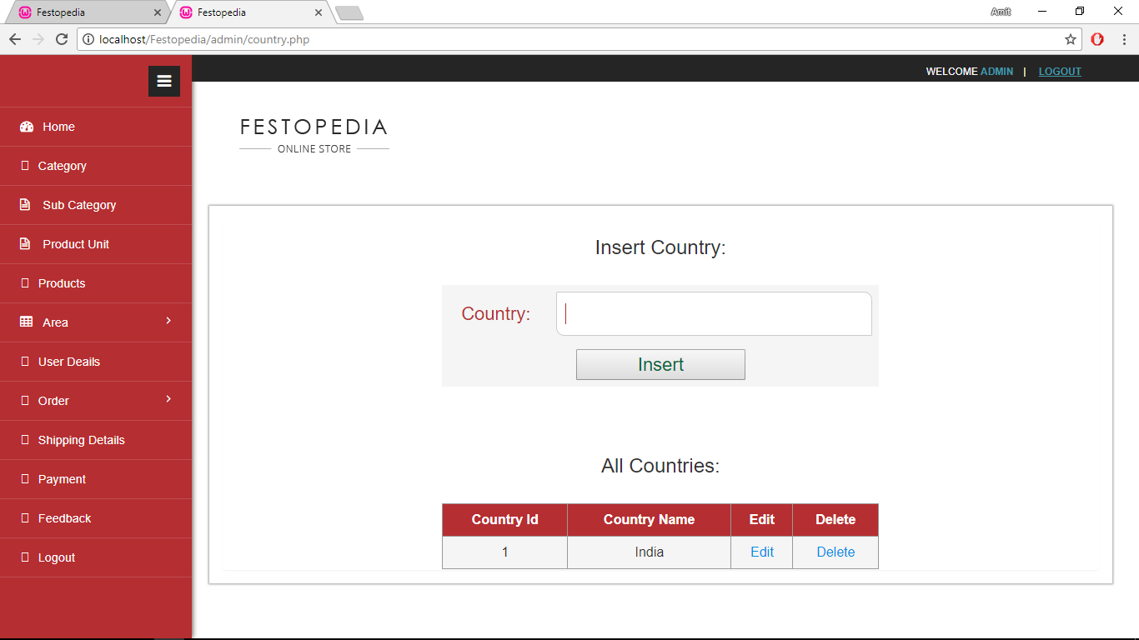
Country Details

Slide 16
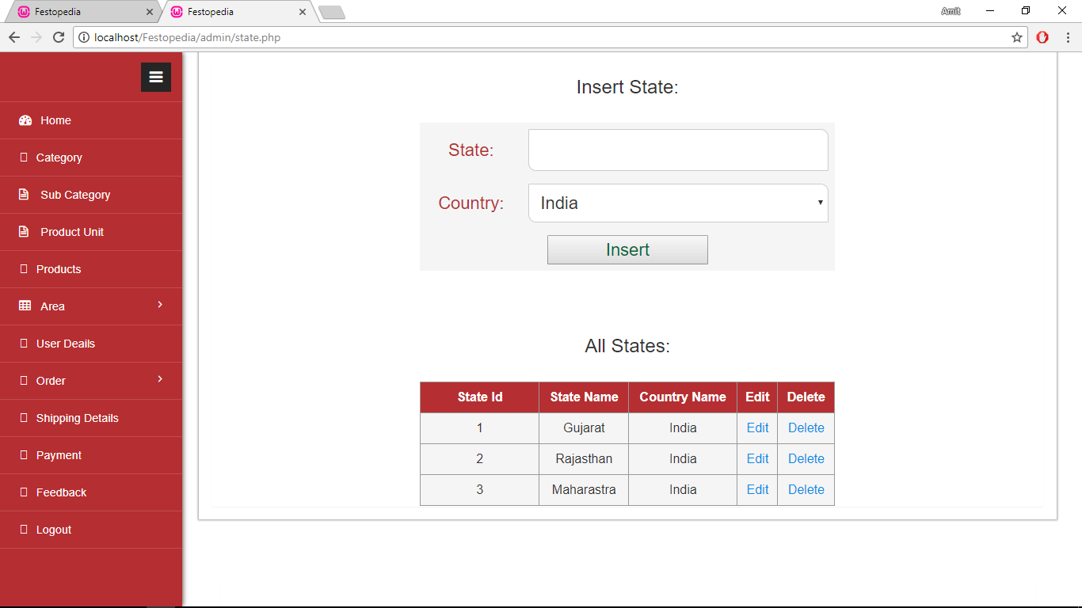
State Details

Slide 17
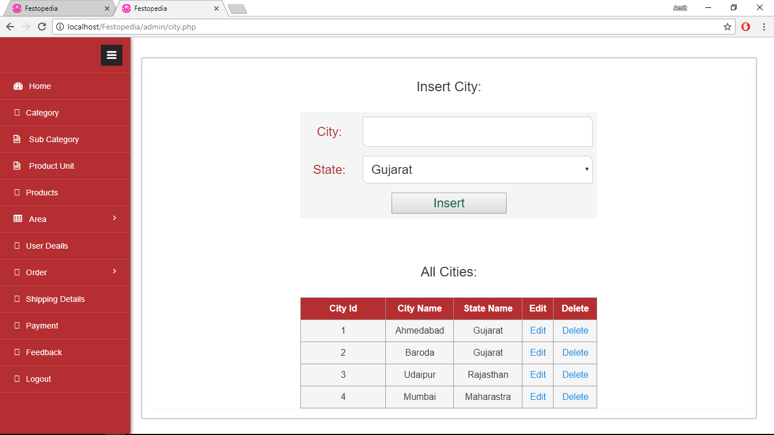
City Details

Slide 18
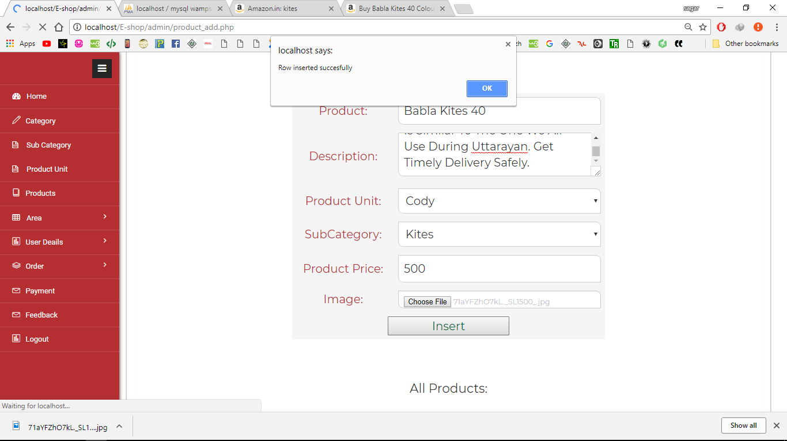
Product Insert

Slide 19
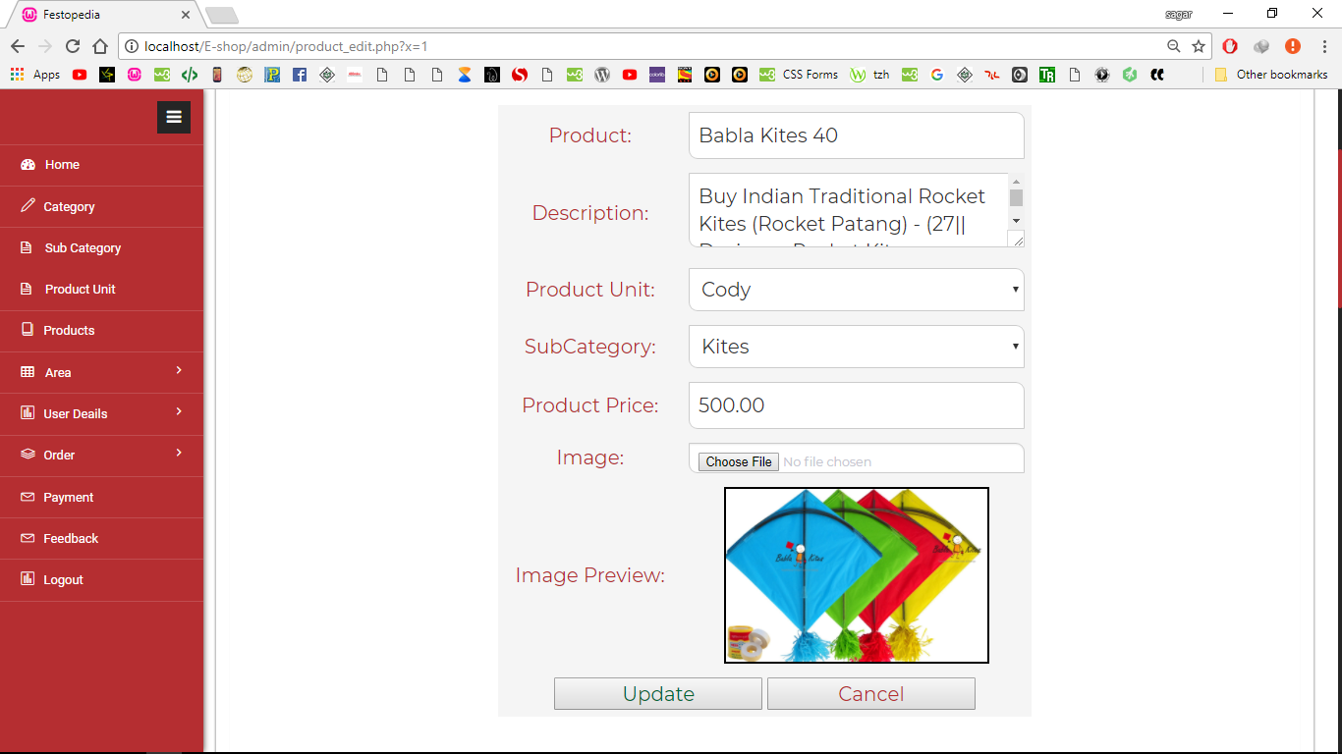
Product Edit

Slide 20
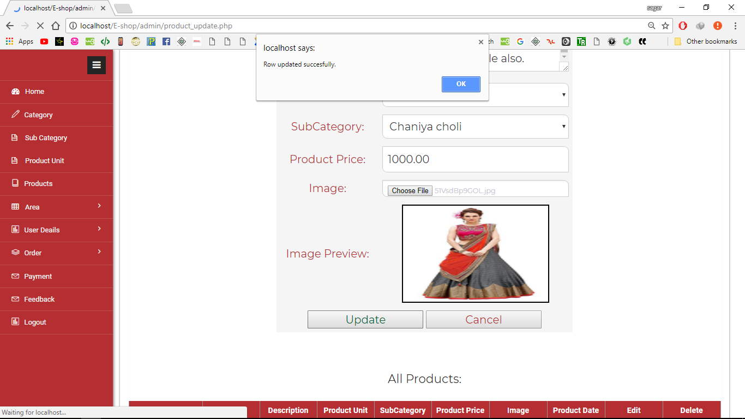
Product Update

Slide 21
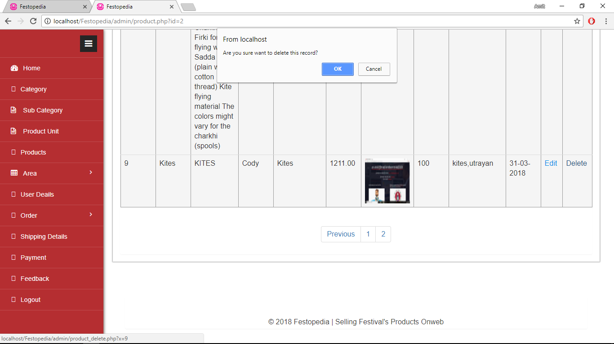
Product delete

Slide 22
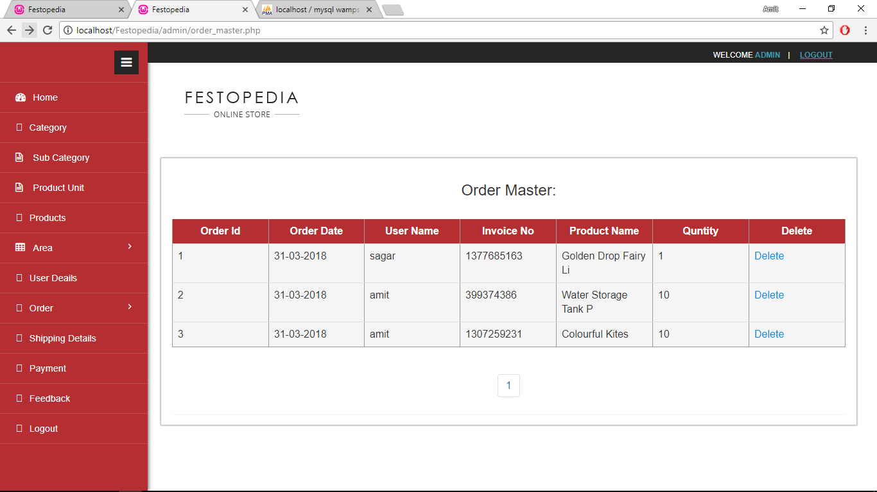
Order Master

Slide 23

Order Details

Slide 24
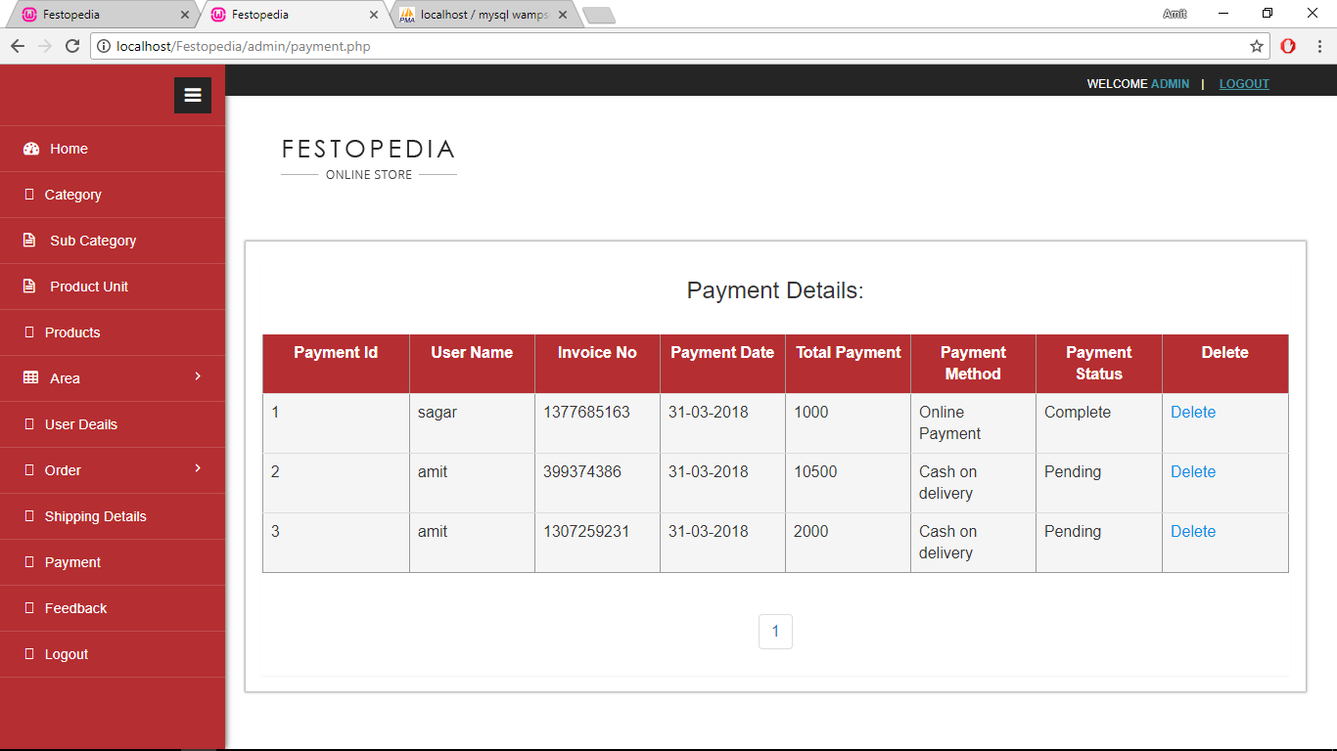
Payment Details

Slide 25
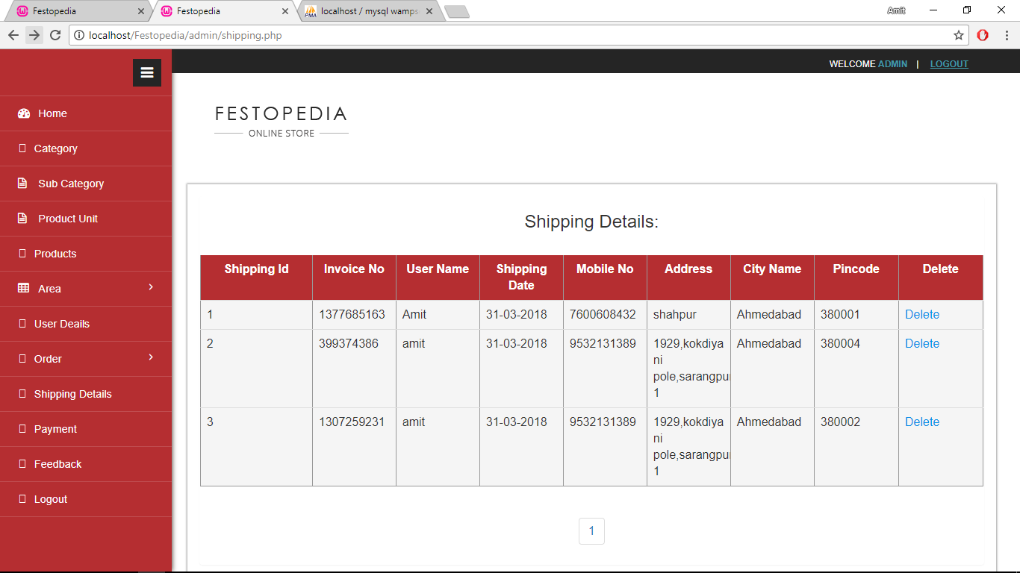
Shipping Details

Slide 26
Screen layout(User side)

Slide 27
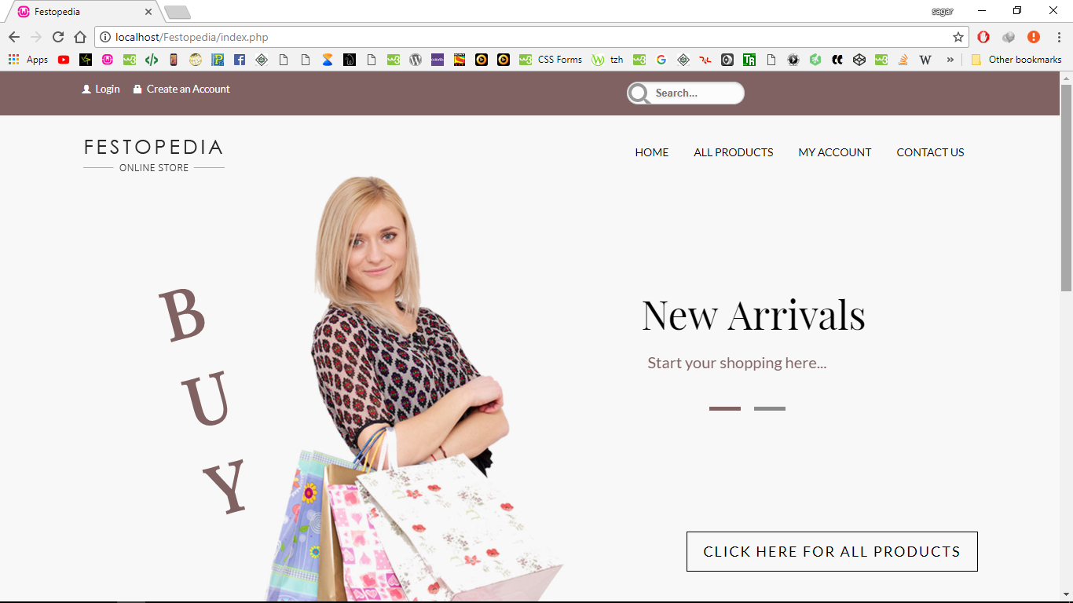
Home Page

Slide 28
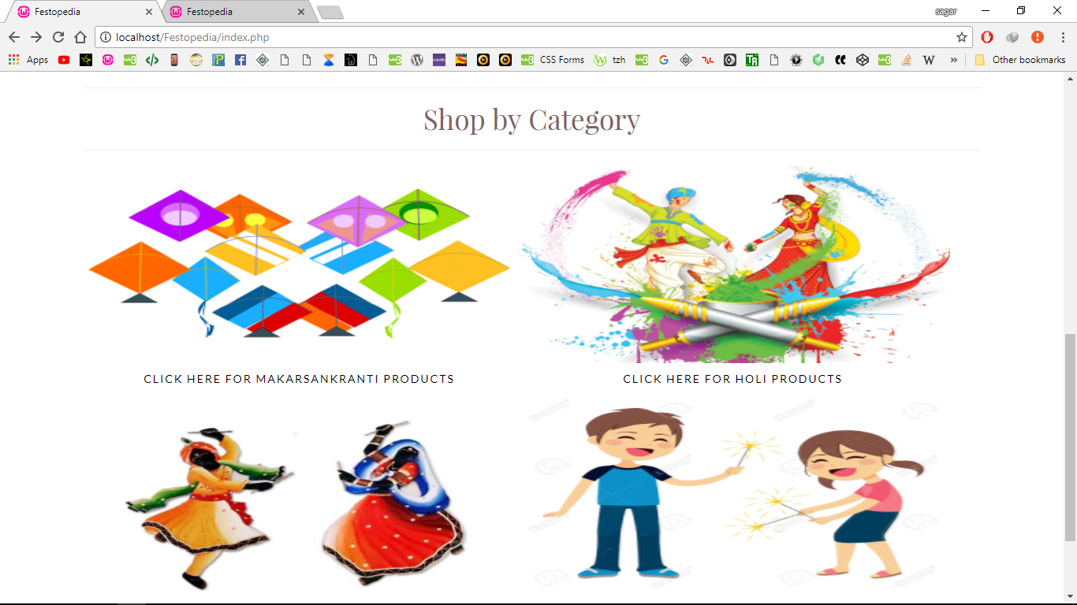
Home Page

Slide 29
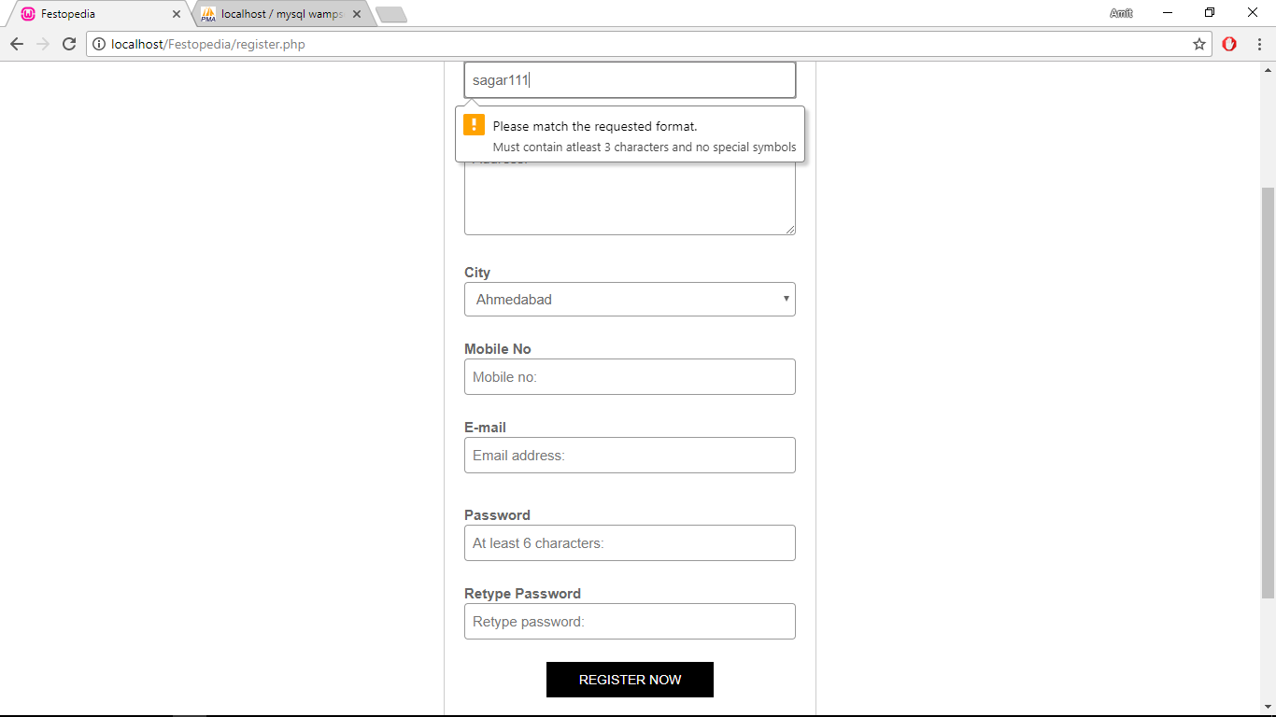
Registration Page Validation

Slide 30
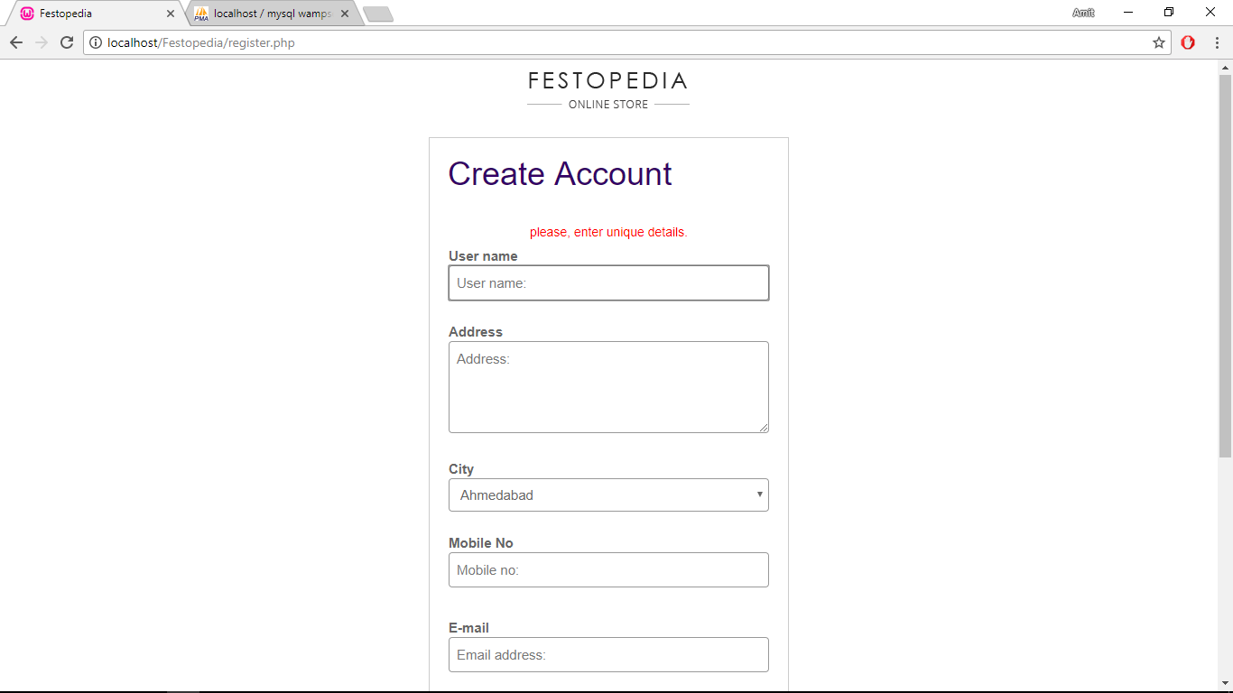
Error Registration

Slide 31
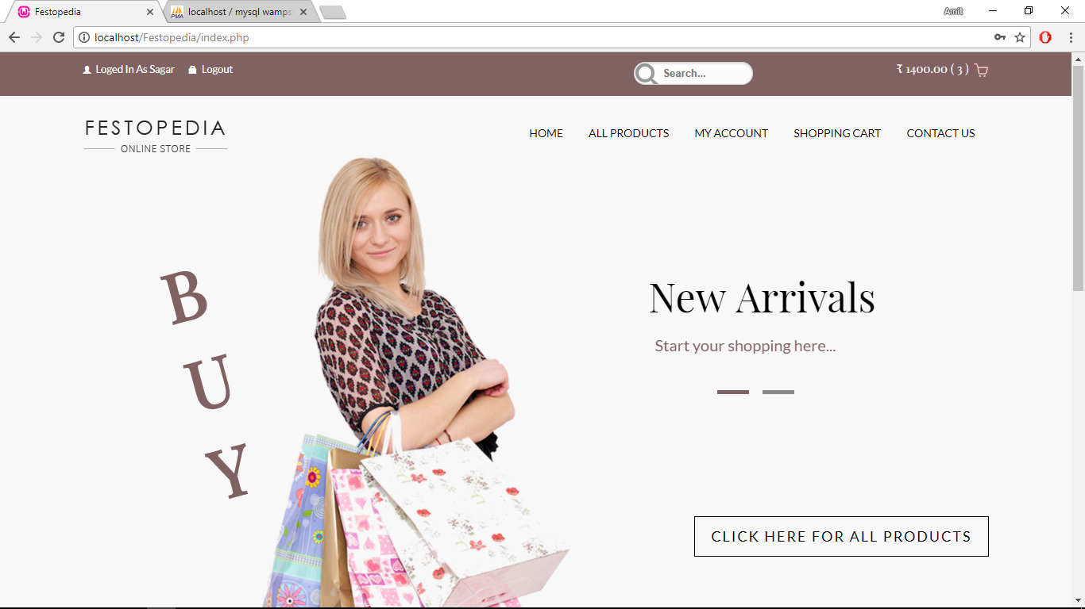
Success Registration

Slide 32
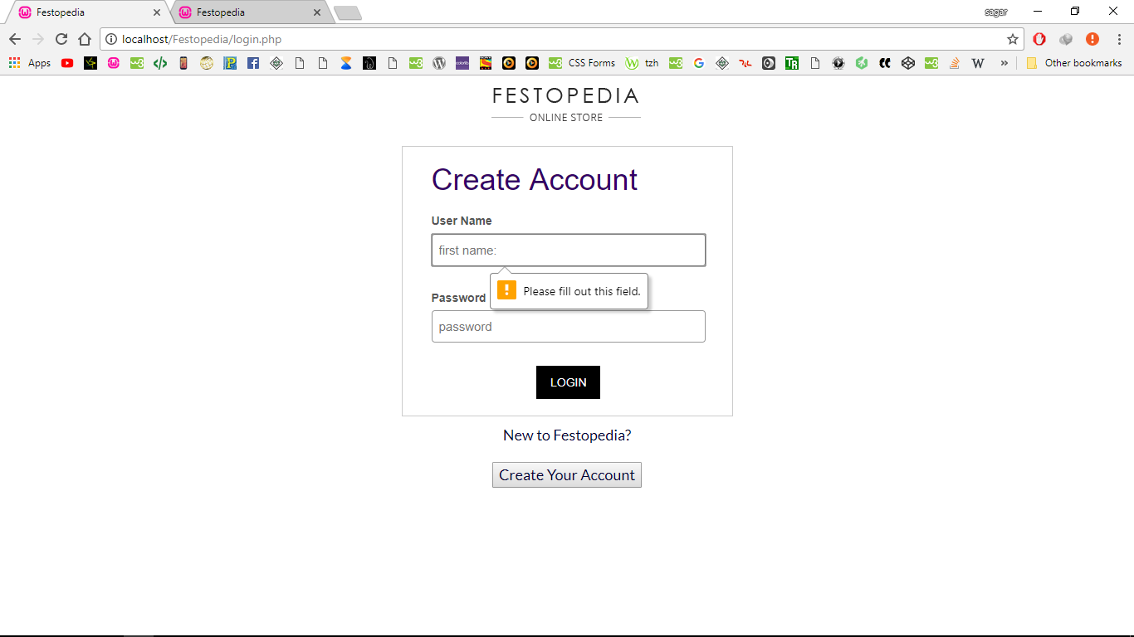
Validation login page

Slide 33
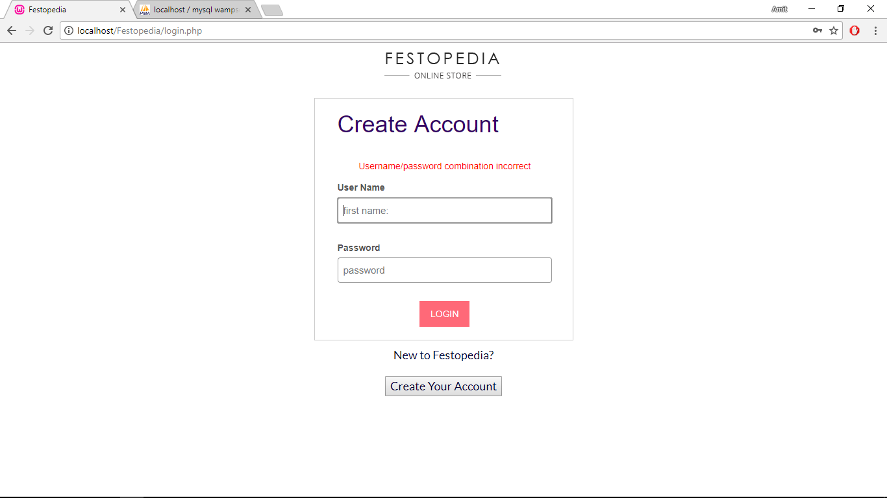
Error login page

Slide 34
Success login page

Slide 35
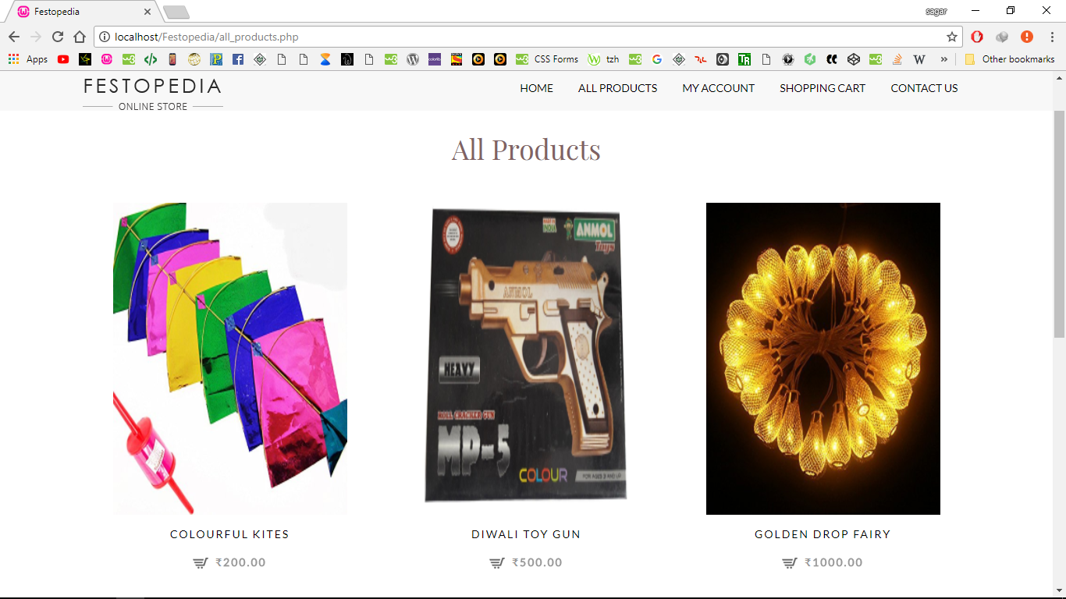
All Products

Slide 36
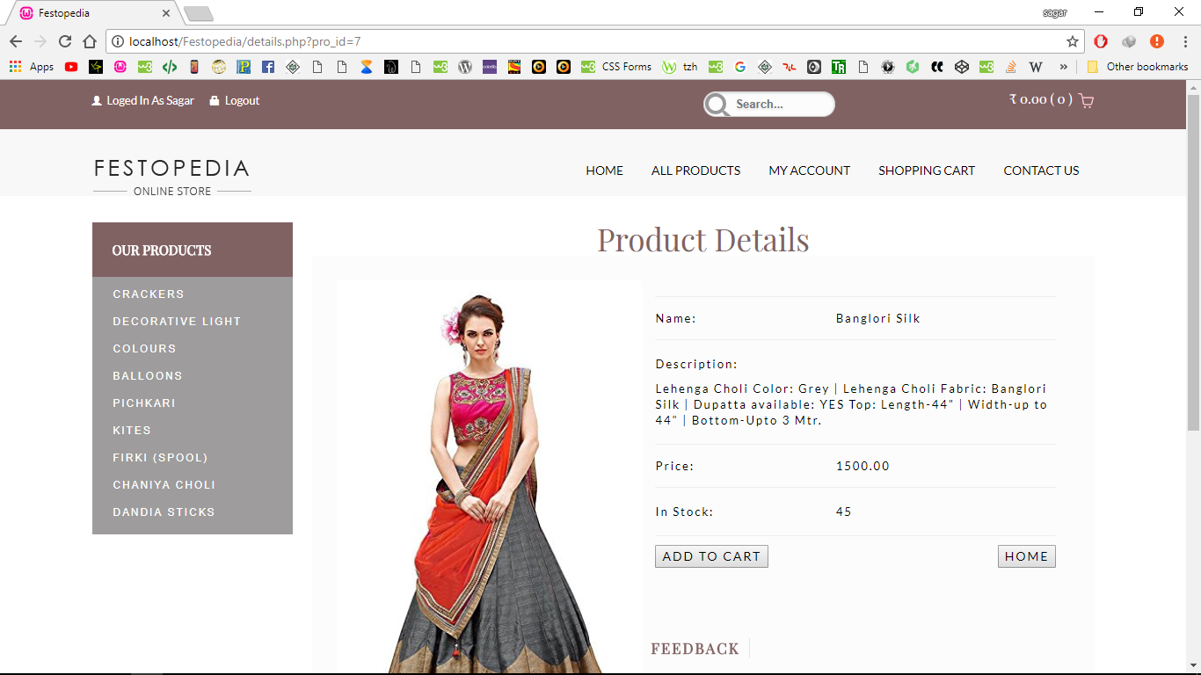
Product Details

Slide 37
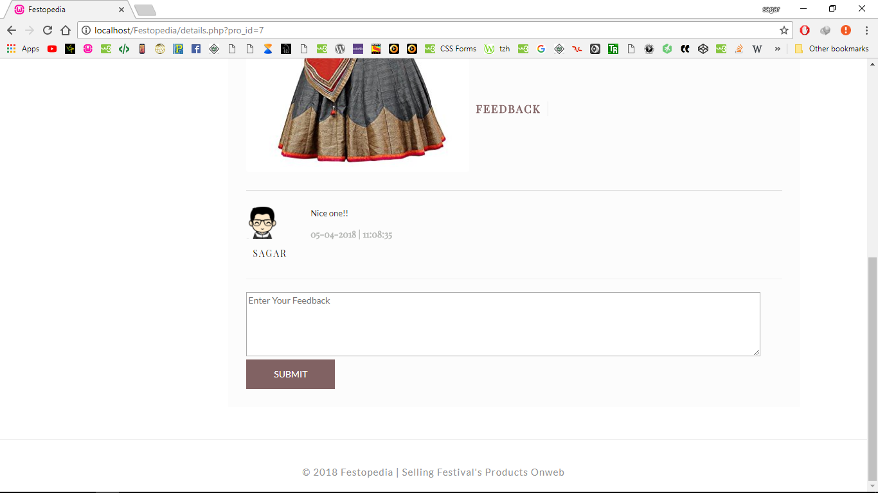
User Feedback

Slide 38
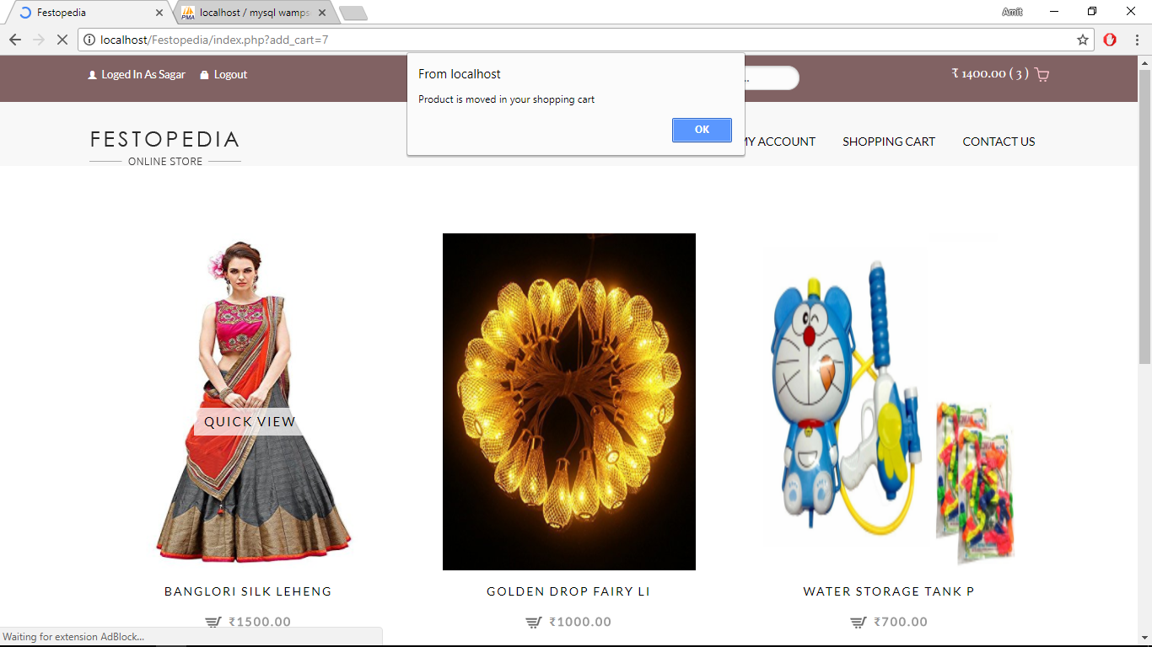
Add Product To Cart

Slide 39
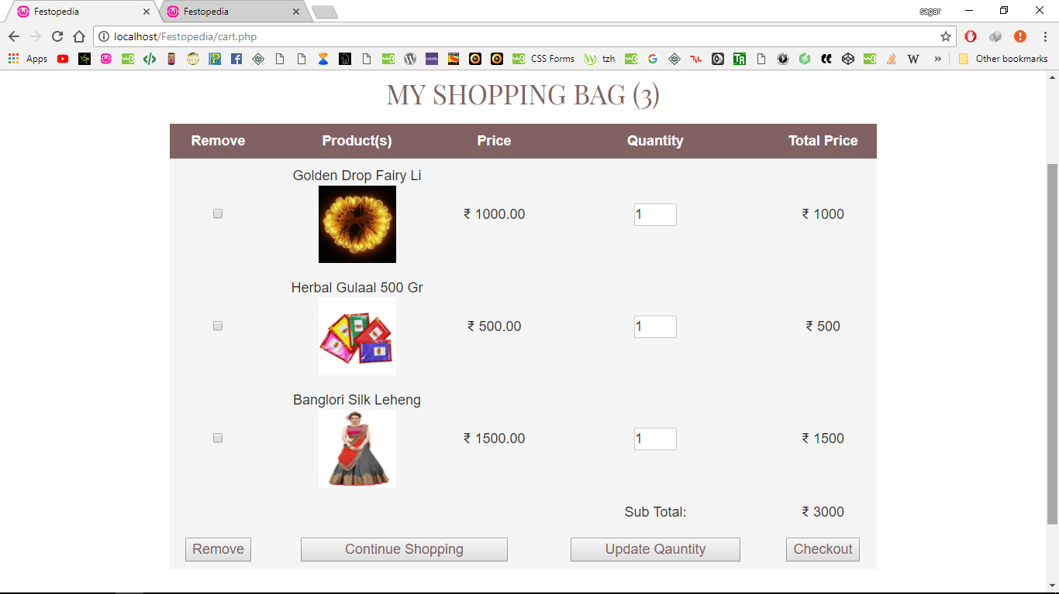
View Cart Items

Slide 40
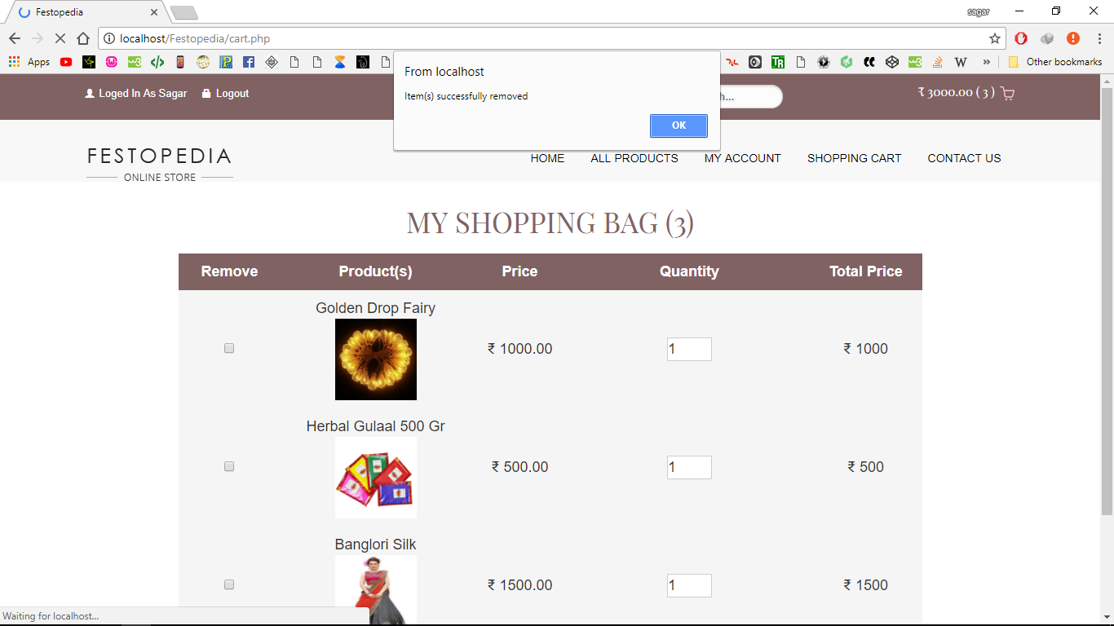
Remove Cart Item

Slide 41
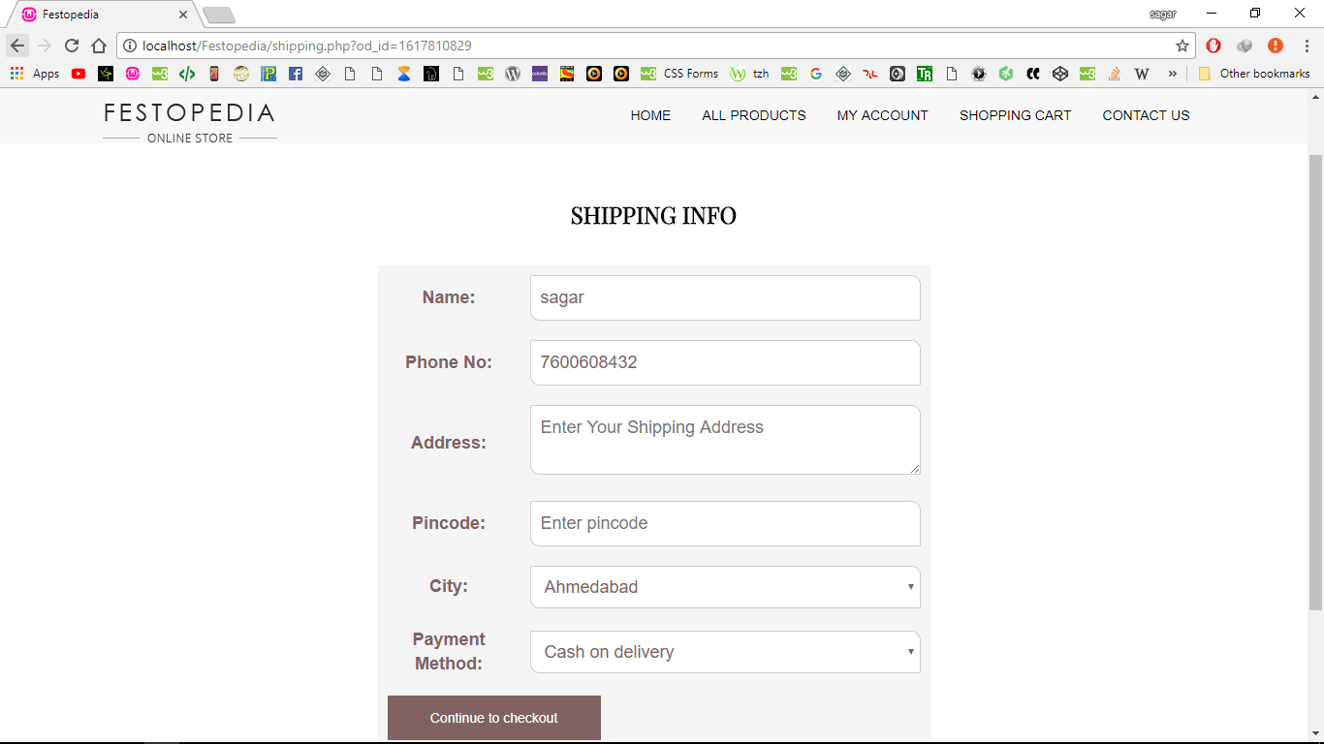
Shipping Information

Slide 42
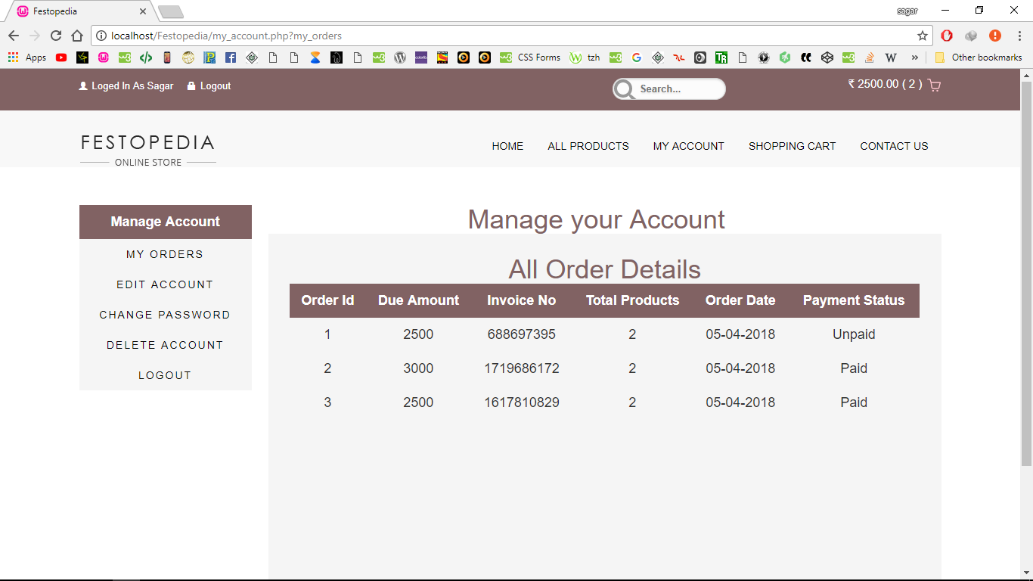
Order Details

Slide 43
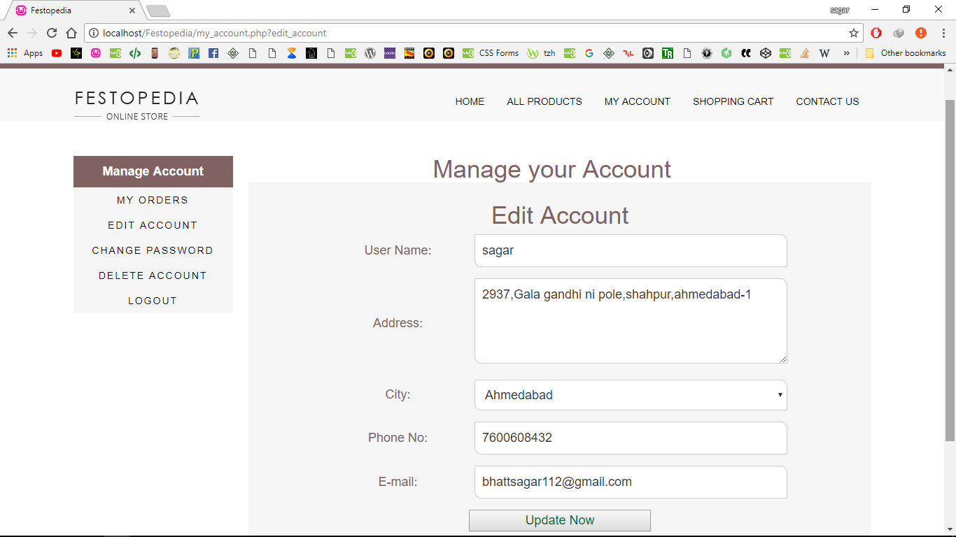
Edit Account

Slide 44
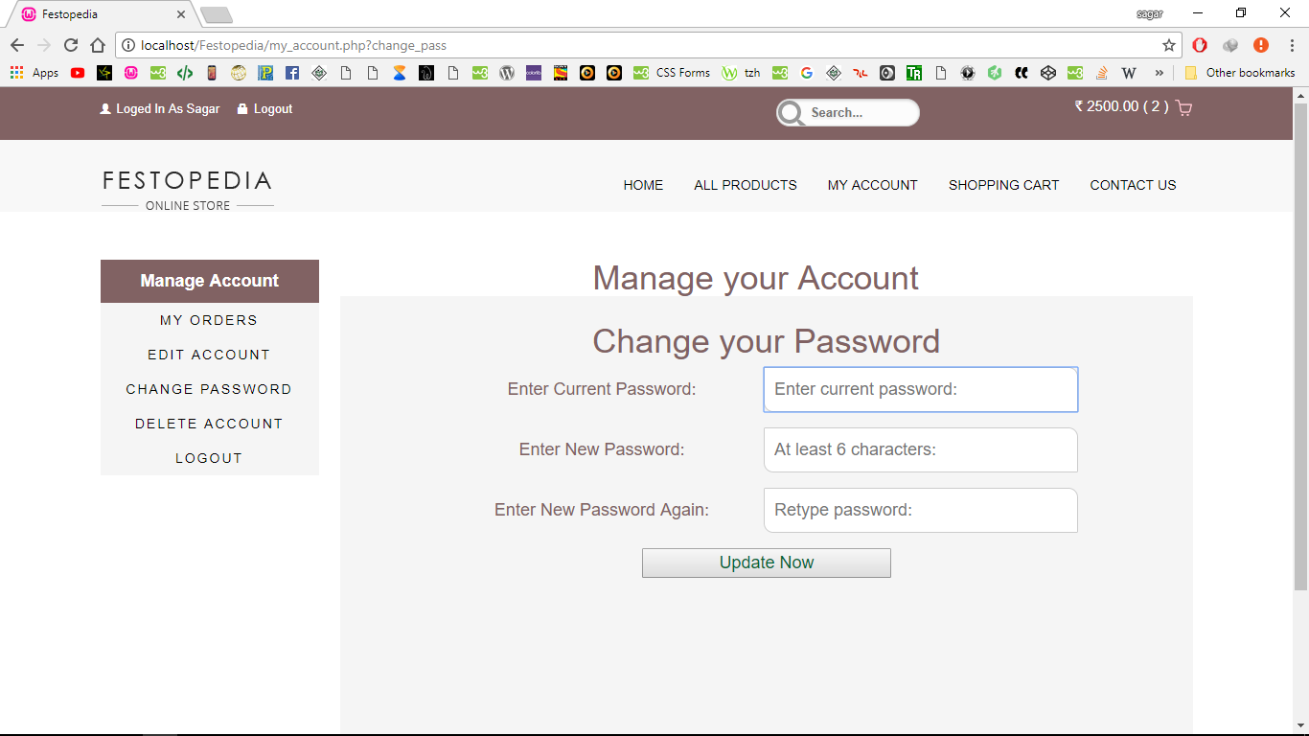
Change Account Password

Slide 45
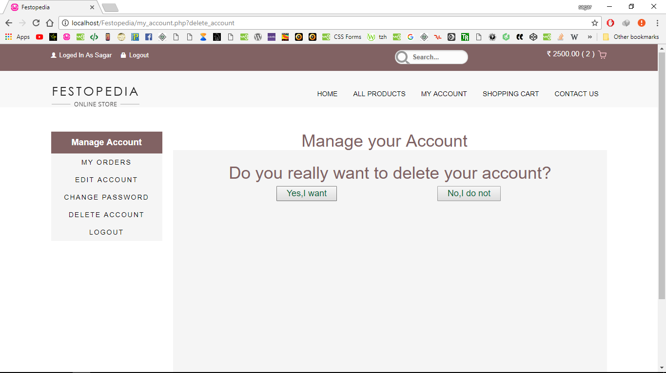
Delete Account

Slide 46
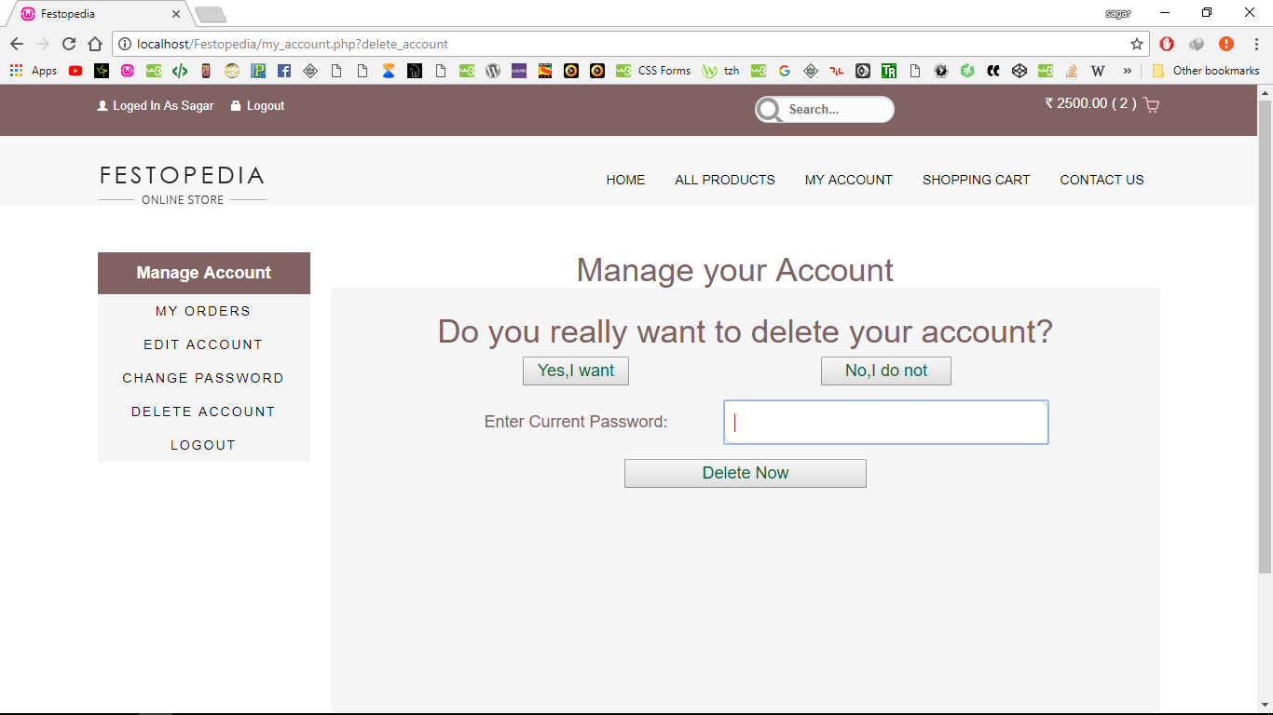
Confirmation for Delete

Slide 47
Report layout

Slide 48
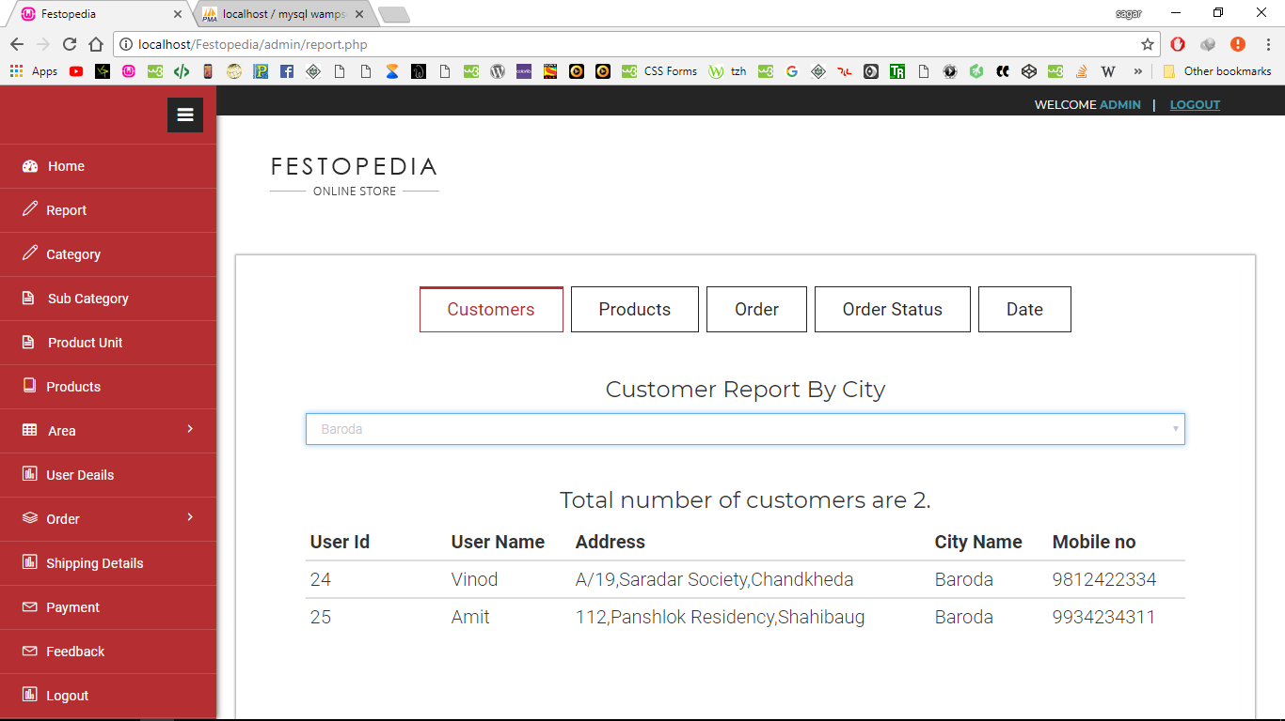
Customer Report By City

Slide 49
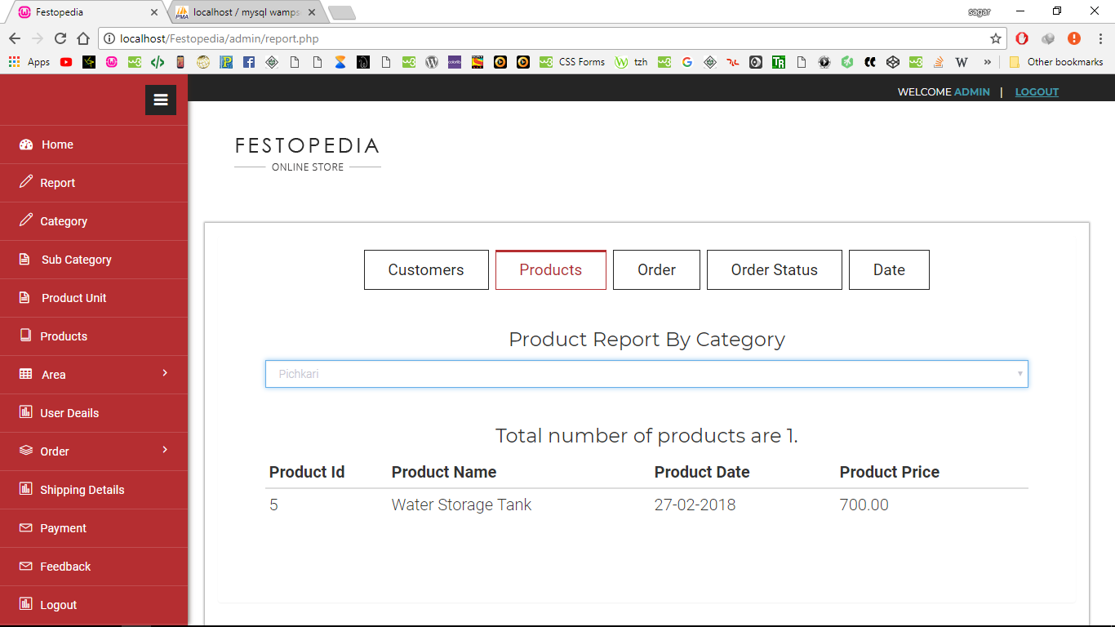
Product Report By Category

Slide 50
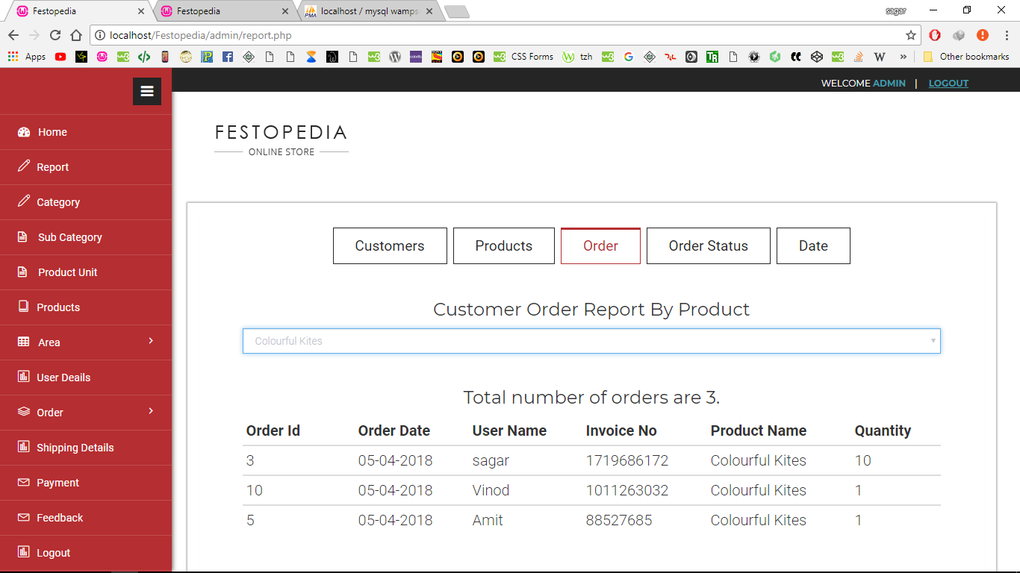
Order Report By Product

Slide 51

Order Report By Order Status

Slide 52
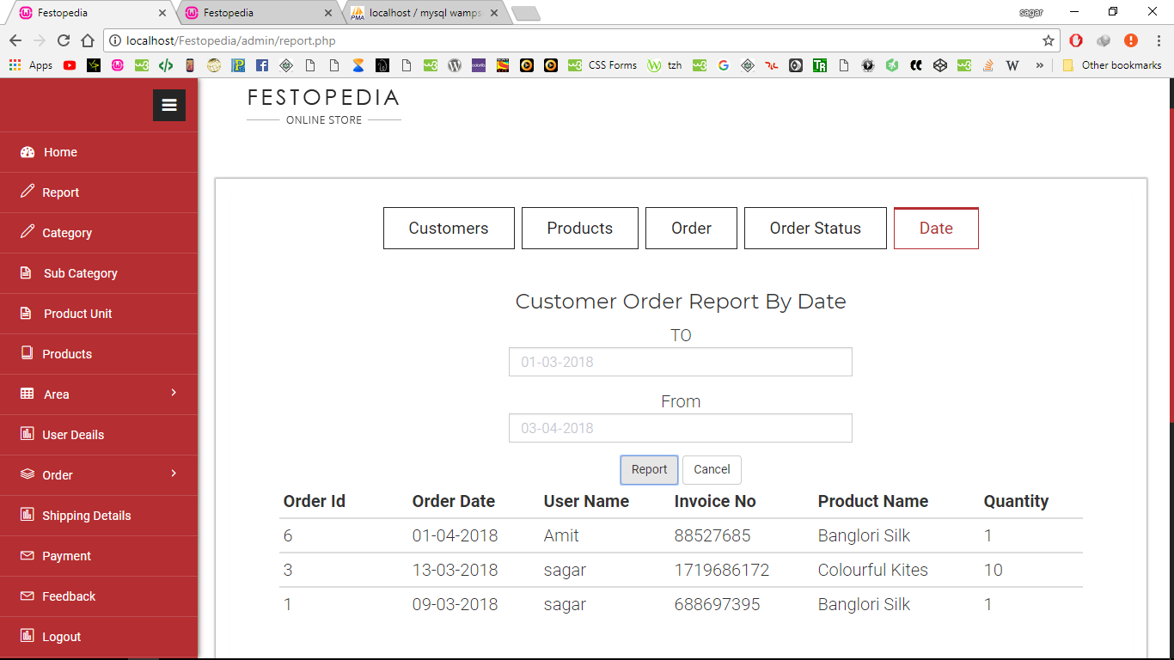
Order Report By Date

Slide 53


